Slide 1

Access101
The missing parts

Slide 2
<meta />
What is meta tag and why do you need to care?

Slide 3
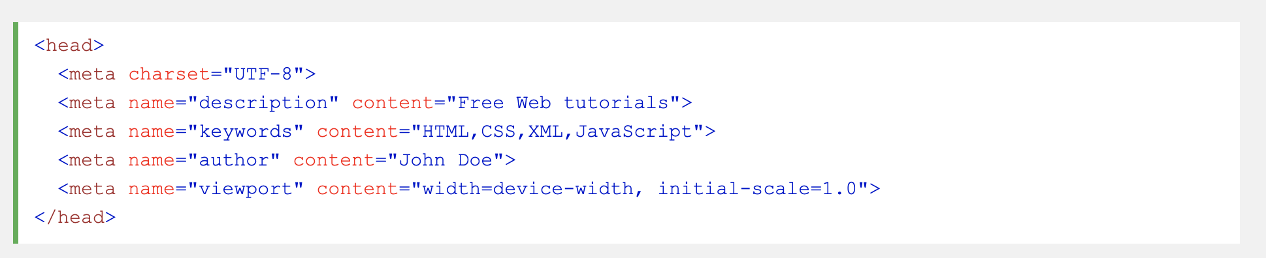

Slide 4
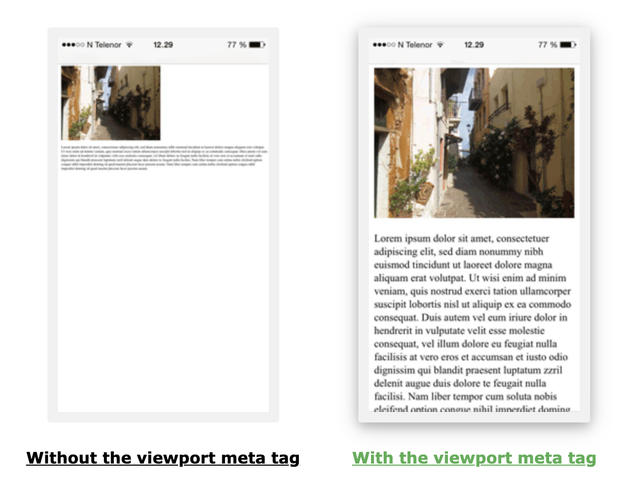

Slide 5
Let’s talk about..
accessibility

Slide 6
prettier
…a code formatter

Slide 7
codesandbox
…a trial

Slide 8
🎉

